Slide 1


Network protocols & security
24EC2210
Topic:
IPv6 addressing
Session – 14

Slide 2



AIM OF THE SESSION
To familiarize students with the concepts of IPv6 Addressing.
INSTRUCTIONAL OBJECTIVES
This Session is designed to:
Describe the address space of IPv6.
Describe the concepts of IPv6 addressing.
LEARNING OUTCOMES
At the end of this session, the student will be able to:
Understand the need for IPv6 and its address space.
Identify the short and extended notations of IPv6.

Slide 3
AGENDA
IPv6 Address​es
IPv6 Address Space
IPv6 Short Notation

Slide 4
Internet Protocol version 6 (IPv6)
Despite all short-term solutions, address depletion is still a long-term problem for the Internet.
This and other problems in the IP protocol itself have been the motivation for IPv6.
IPv6 is a 128-bits address.
IPv6 use Hexa-Decimal format separated by colon (:) .

Slide 5
IPv6 Address SPACE
The total number of addresses used by the protocol. If a protocol uses N bits to define an address, the address space is 2^{N} because each bit can have two different values (0 or 1) and N bits can have 2^{N} values.
The address space of IPv4 is 2³² or 4,294,967,296.
The address space of IPv6 is 2¹²⁸ or 40,282,366,920,938,463,463,374,607,431,768,211,456.
The address space of IPv6 is much larger than the IPv4.

Slide 6
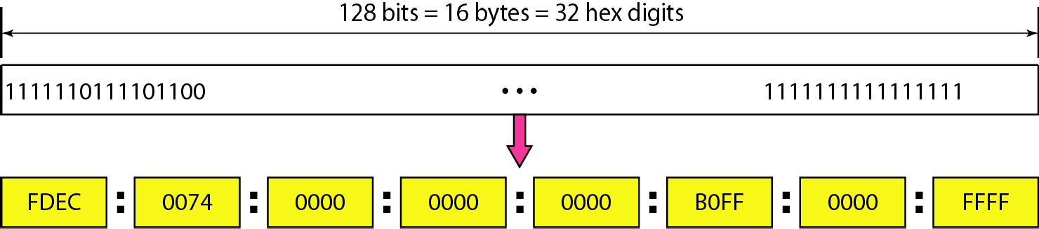
Internet Protocol version 6 (IPv6)
Components in Address format :
There are 8 groups and each group represents 2 Bytes (16-bits).
Each Hex-Digit is of 4 bits (1 nibble)
Delimiter used – colon (:)

Slide 7
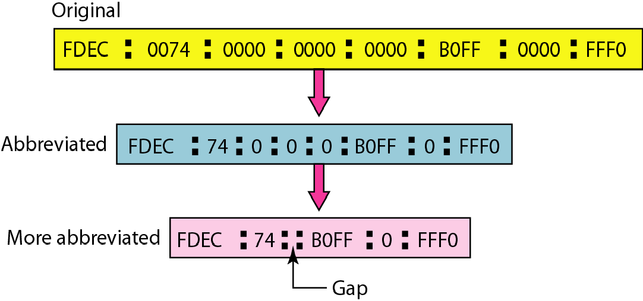
Short notation of IPv6 or Abbreviated IPv6 address

Slide 8
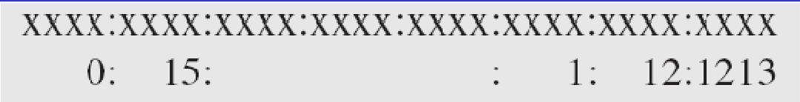
Expansion of IPv6 address from its short notation
Example: Expand the address 0:15::1:12:1213 to its original.
Solution
We first need to align the left side of the double colon to the left of the original pattern and the right side of the double colon to the right of the original pattern to find how many 0s we need to replace the double colon.
This means that the original address is.

Slide 9
REFERENCES FOR FURTHER LEARNING OF THE SESSION
Reference Books:
1. Data Communications and Networking, Behrouz A. Forouzan, 4th Edition, McGraw Hill.
2. Computer Networks, Tanenbaum, 6th Edition, Pearson.
Sites and Web links:
CISCO Academy
NPTEL, Computer Networks and Internet Protocols, Prof. Soumya Kanti Ghosh, Prof. Sandip Chakraborty IIT Kharagpur. (https://nptel.ac.in/courses/106105183)

Slide 10
THANK YOU
Team – Networks Protocols & Security

